Slide 1
Variation of SBE (Spent Bleaching earth) Deoiling Treatment’s Effect on Post-Treated SBE (PSBE)’s Quality and Strength Activity Index (SAI)
Quantity
Post Treatment -> Post De-oiled SBE => Treatment => PSBE
Observed from samples containing PSBE; Compared with PCC & Fly ash
By: Jordan, Jevon 2023

Slide 2
Hypothesis
1. The largest amount of acetone would produce the least amount of oil
2. Fly ash would increase both paste and mortar compressive strength while PSBE would lower both paste and mortar compressive strength
3. PSBE would contain undesirable effect that could affect paste and mortars.

Slide 3
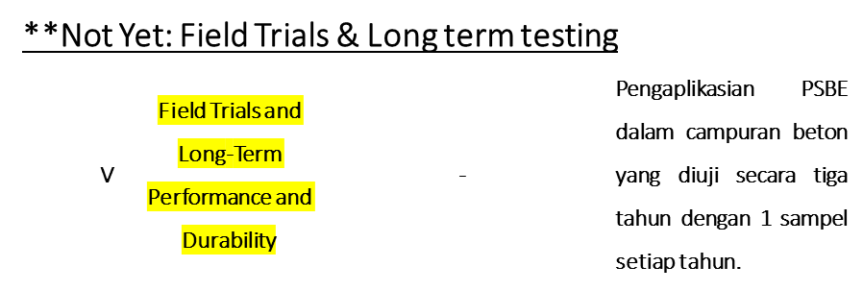
Testing Guide
ASCM C1709
ASTM C618
Components | Percentage |  | Total (% Al₂O₃+SiO₂+Fe₂O₃) |  | Total (% SO₃)
 | PSBE_T | Fly ash | PSBE_T | Fly ash | PSBE_T | Fly ash
Al₂O₃ | 4 | 7.4 | 68.7 | 64.85 | 1.4 | 2.2
SiO₂ | 38 | 20.5
Fe₂O₃ | 26.7 | 36.95
SO₃ | 1.4 | 2.2
!Doesn’t Guarantee Anything Except the Sole Amount of QTY
Why => Time Constraint, Budget, & Usage

Slide 4
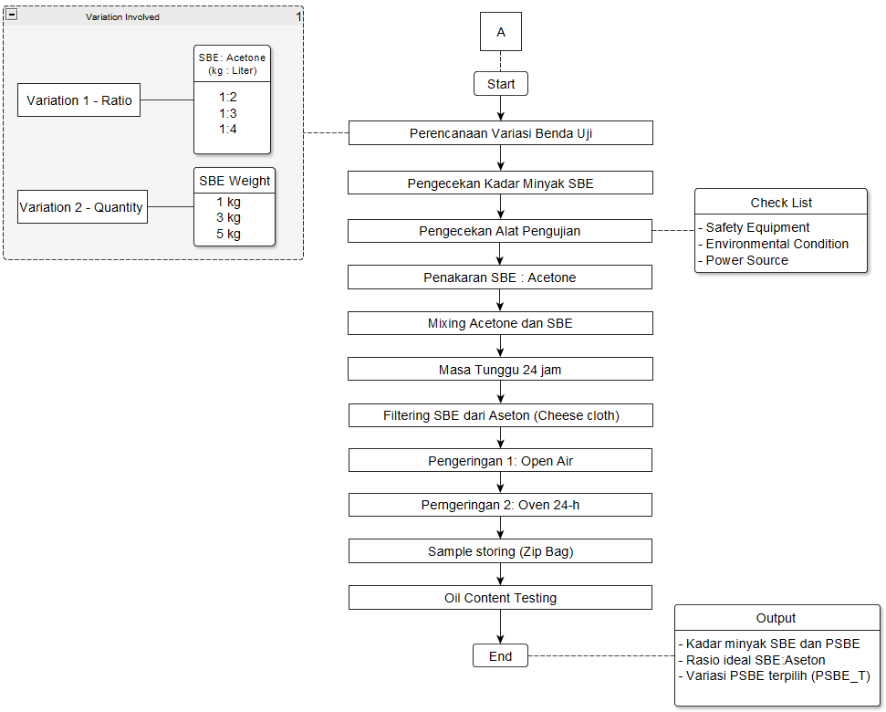
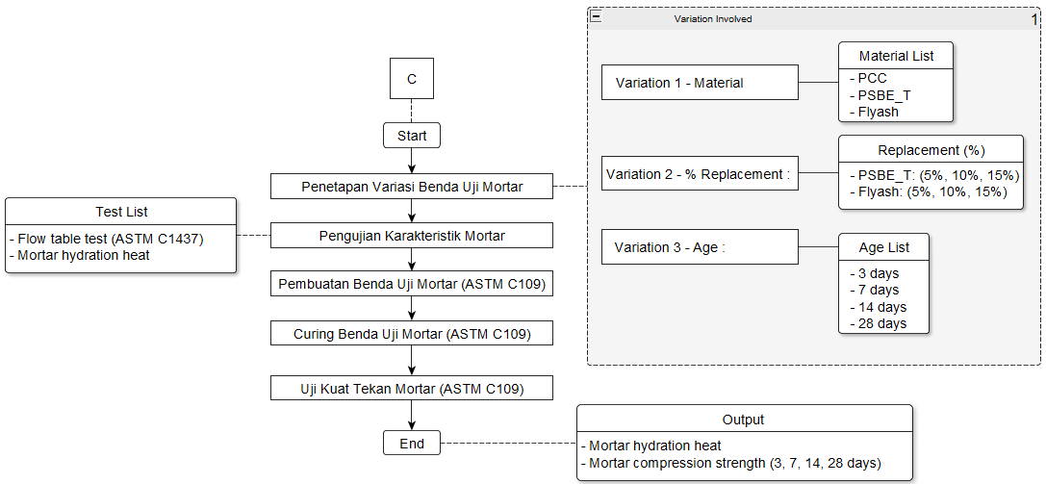
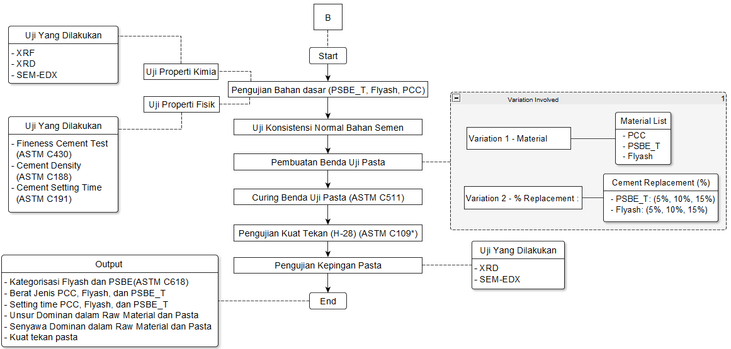
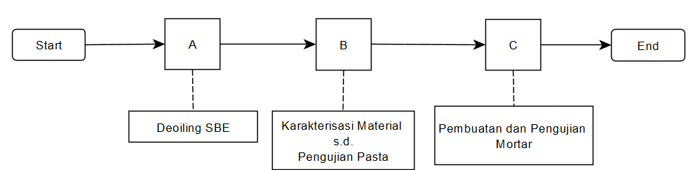
Research Procedure

Slide 5
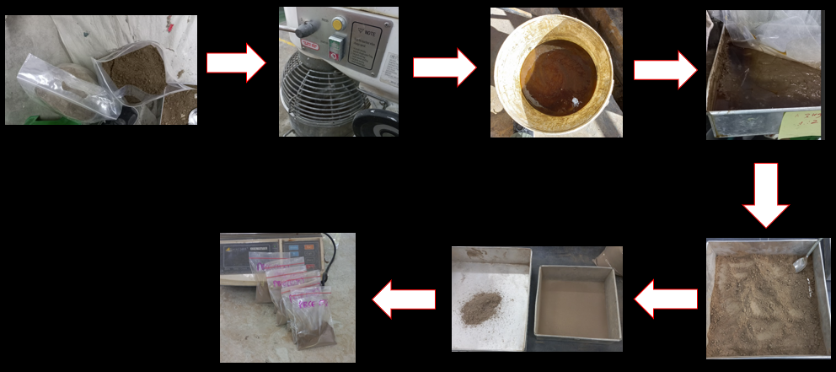
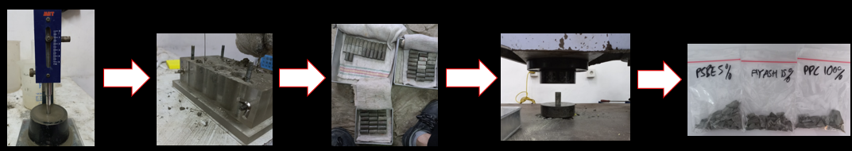
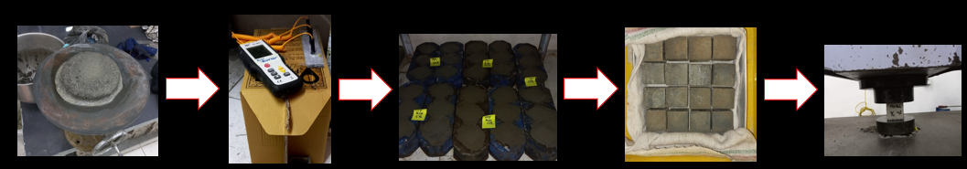
Imagery
A
B
Paste Making + Testing
Deoilling/Treatment Procedure
C
Mortar Making + Testing

Slide 6
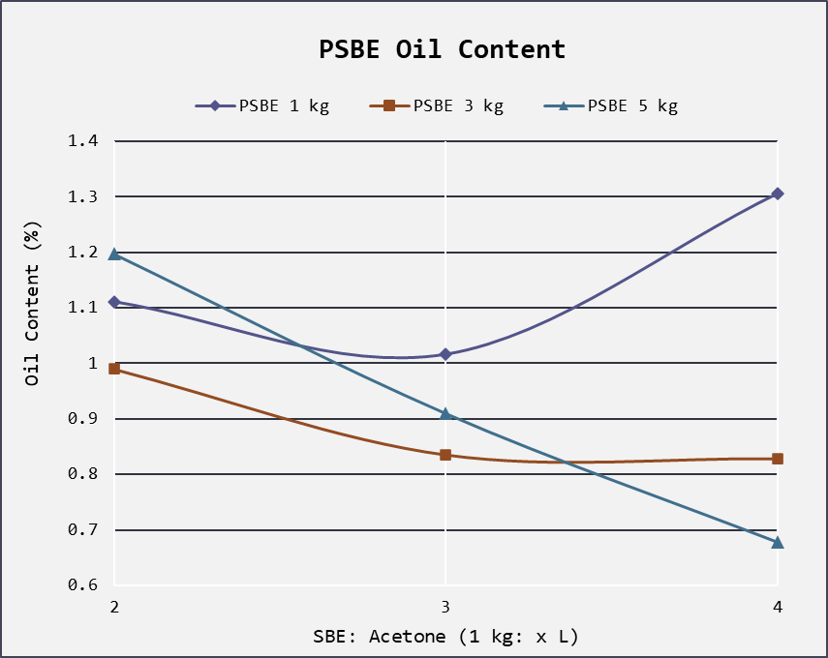
1. Oil Content
!No significance difference is found from treating SBE with different quantity
Rp. 450.000,-
Rp. 900.000,-
This would be chosen as PSBE_T

Slide 7
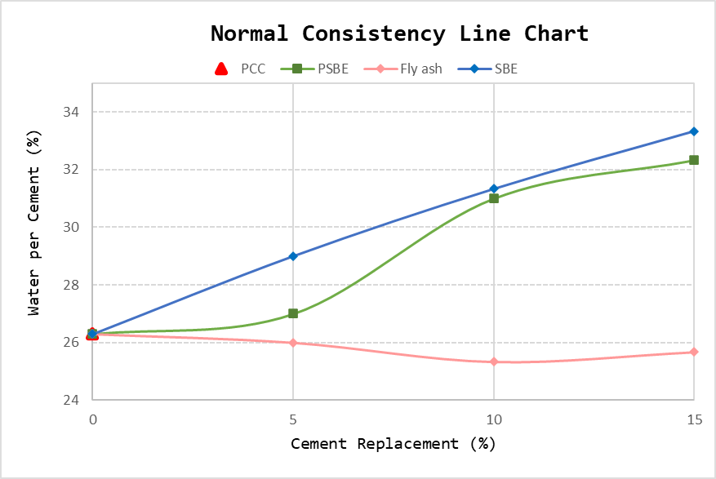
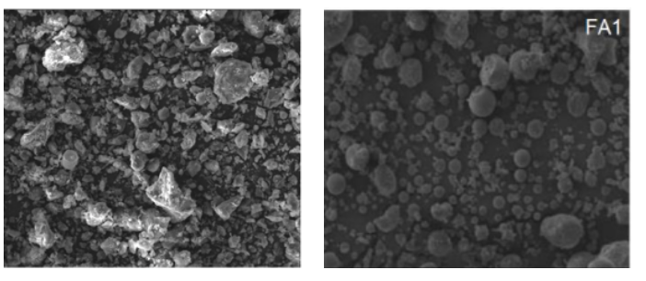
2. Normal Consistency
**Raises the amount of water needed
**Lowers the amount of water needed
WHY???
Physical Characteristic of The Material
PSBE
Fly ash
Those with rounder shape would yield a better result since the overall surface area would be larger than those with rough edges or uneven shape (A.M. Neville and J.J. Brooks, Concrete Technology, 2017)
SEM @1000x

Slide 8

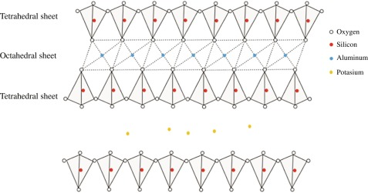
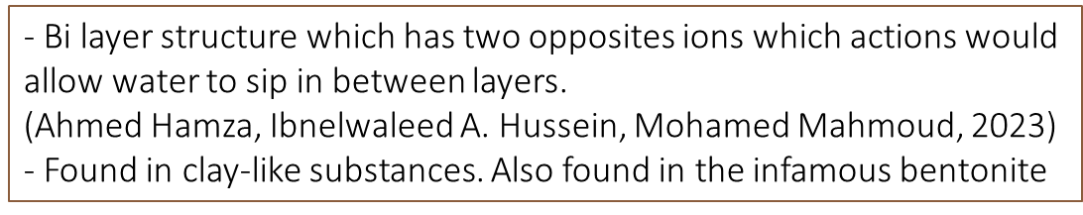
Chemical Characteristic of The Material
SBE Oil (%)
PSBE Oil (%)
PBSE_2_5 | 5 | 10 | 30 | 22.86 | 1.1977 | 94.76
! Both Oil & Illite would cause this devastating effect
Water sips in here

Slide 9
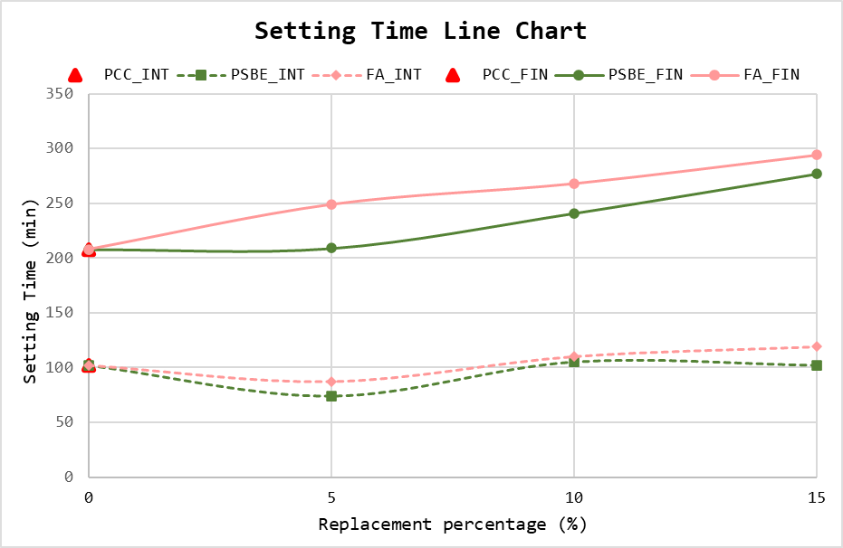
3. Setting Time
! Both PSBE_T & Fly ash Increased Setting Time

Slide 10
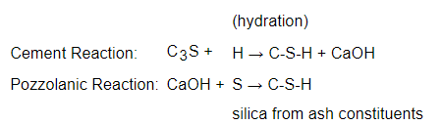
PSBE
Illite, Cristabolite, Sodalite, Gaylusite
PSBE
SBE
Cristobalite low | SiO₂ | 3.04 | 0.19
Illite | Al₄KO₁₂Si₂ | 15.07 | 8.74
! This Substances Increases
Fly ash
Pozzolanic (Tobermorite Gel)
Would caused prolonged setting time since the whole thing is wrap
In a gel like substances.
*Found in the metamorphosed lime
! Both PSBE & Fly ash caused prolonged setting time with different reasons

Slide 11
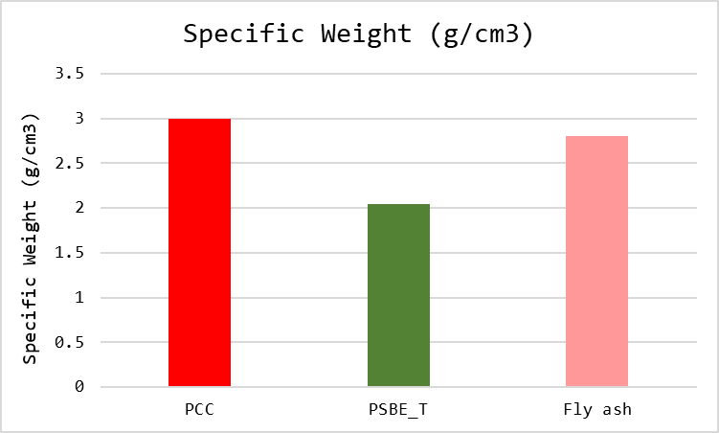
4. Specific Weight
Sample Name | Specific Weight (g/cm³)
PCC | 3
PSBE_T | 2.04
Fly ash | 2.8
Confirmation:
Nama Sampel | Apparent density (kg/m³)
Cement (PCC) | 3,090
Fly ash | 2,340
(Changyong et al., 2020)
PSBE => 1.9-2.1 g/cc (Yulikasari et al., 2021)
! Potential to be used as pavement, light concrete, etc. exists

Slide 12
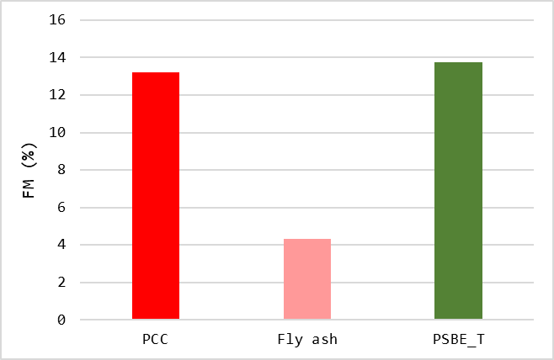
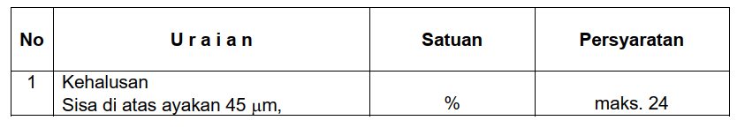
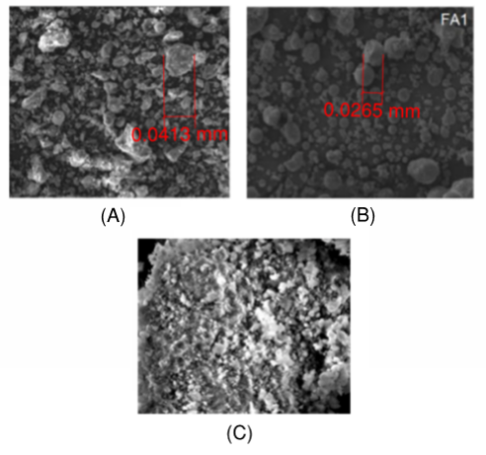
5. Passing Sieve Analysis
Sample Name | Avg. Retained Weight (gr) | Avg. Pass Sieve (gr) | Avg. Total Weight (gr) | Avg. Retained (FM) (%) | Status
PCC | 13.2 | 86.8 | 100 | 13.2 | Pass
Fly ash | 4.33 | 95.67 | 100 | 4.33 | Pass
PSBE_T | 13.73 | 86.2 | 99.93 | 13.74 | Pass
SEM @ 1000x

Slide 13
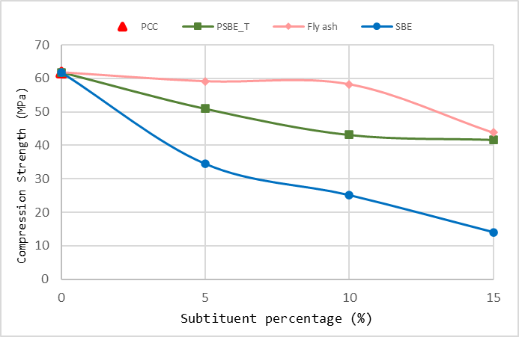
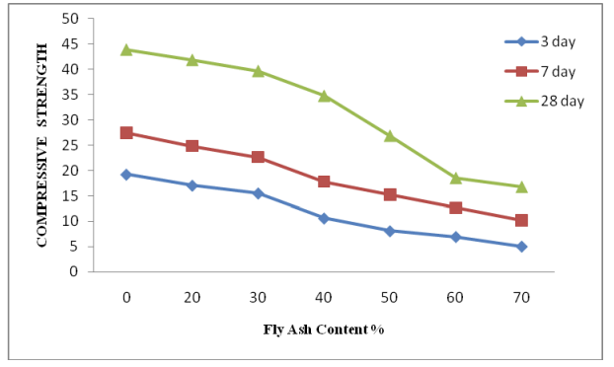
6. Paste Compression Strength
! Addition of substituent materials would lower paste compression
Fly ash > PSBE > SBE
PSBE
SBE
Sodalite | Na₈Al₆Si₆O₂₄BF₄₂ | 12.2 | 3.7
!Sodalite increases material’s strength & Durability (K.M. Klima et al.,2022)

Slide 14
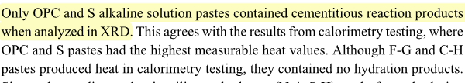
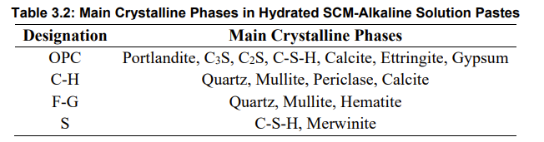
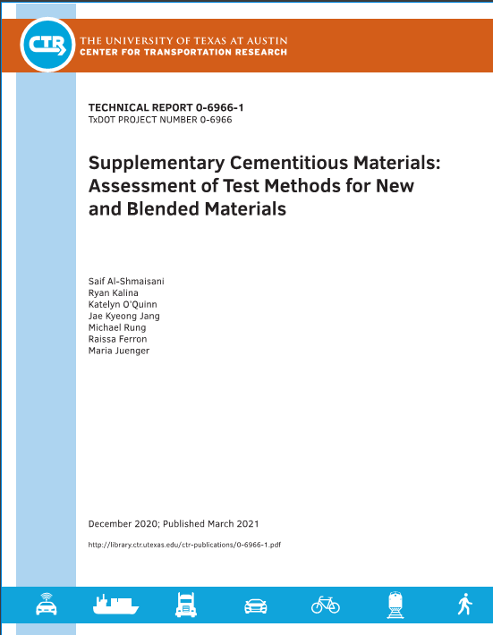
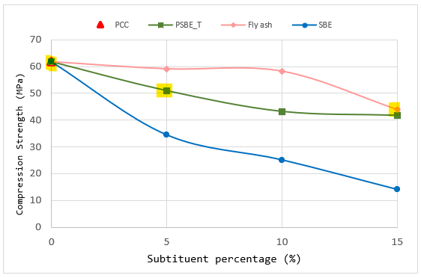
XRD Paste Testing Result
Designation | PCC | PSBE_T_5 | Flyash_15
OPC | 28.13 | 26.53 | 23.4
S | N.A | N.A | N.A
Total | 28.13 | 26.53 | 23.4
PCC > PSBE_T_5 > Flyash_15
! Slight Warning: I am not a certified chemist nor I ‘d like to be one

Slide 15
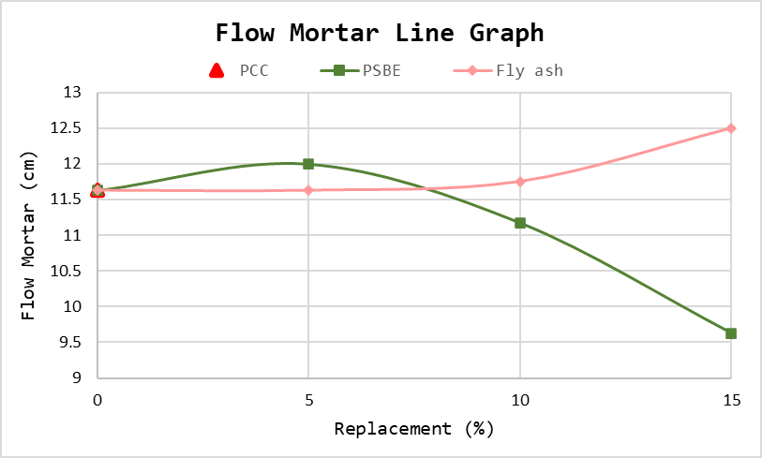

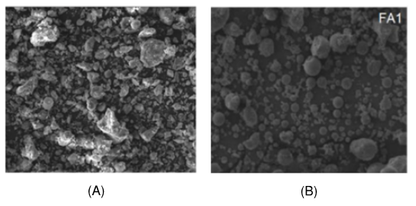
7. Mortar Flow
Illite
Increases water demand
Cristobalite
Increases viscosity
Gaylussite | Na₂Ca (CO₃)₂H₂)₅ | 3.09 | 0.72
! Although Gaylusite could improve mortar’s workability,
The amount is relatively small compared with Illite & Cristabolite low

Slide 16
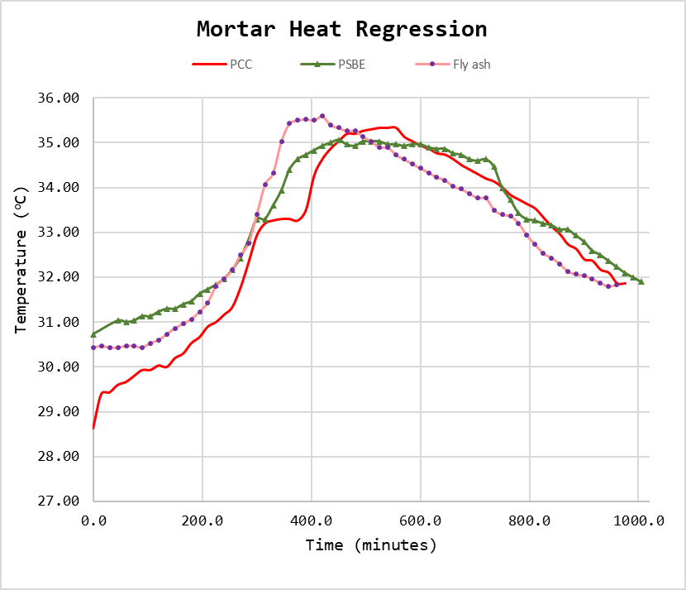
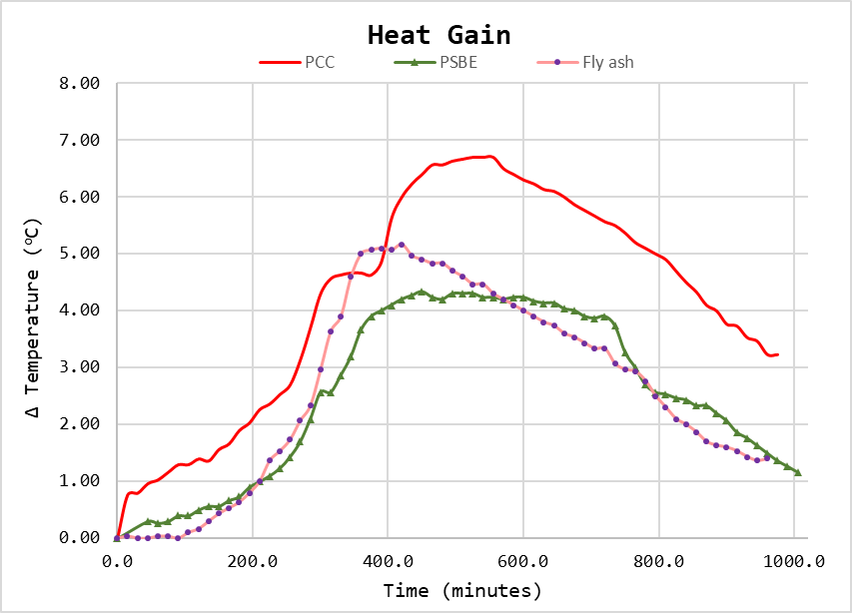
7. Hydration Temperature
PCC has the highest heat gain followed by Fly ash.
! PSBE came in last
! Each mortars’ starts in a different starting temperature

Slide 17
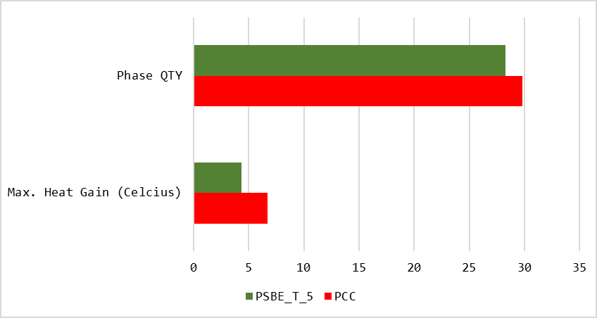
Sample Name | Max. Heat Gain (Cº) | Phase QTY
PCC | 6.7 | 29.8
PSBE_T_5 | 4.33 | 28.27
**All four groups contributes to heat generation
! PSBE_T does indeed produce lower heat gain since it has less amount of heat generation substances
Suitable for bricks or pottery

Slide 18
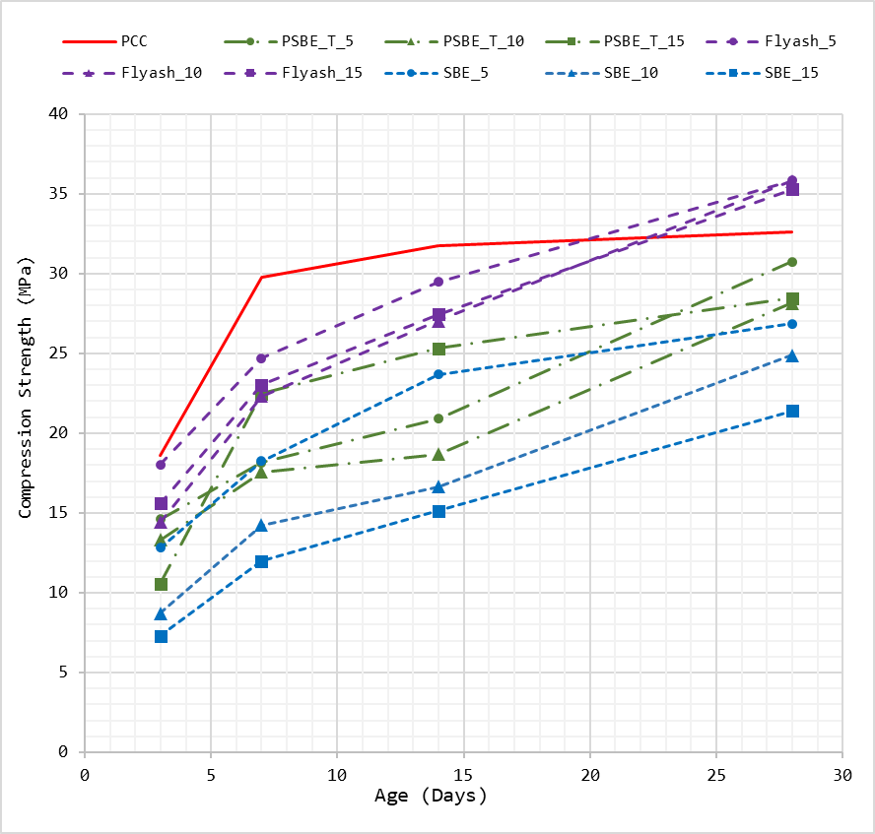
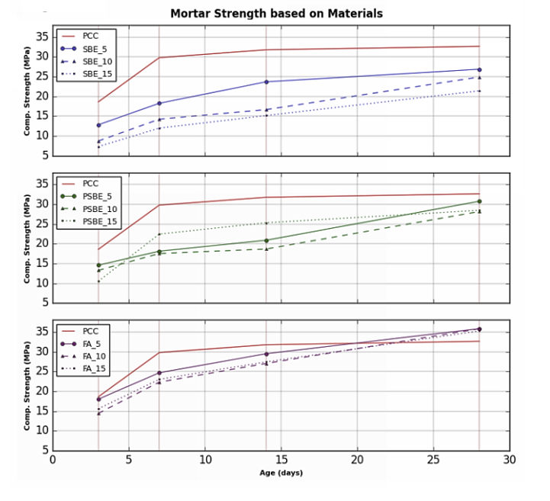
8. Mortar Compression Strength
!This shows the importance of treating SBE before actual usage
Fly ash > PCC > PSBE > SBE

Slide 19
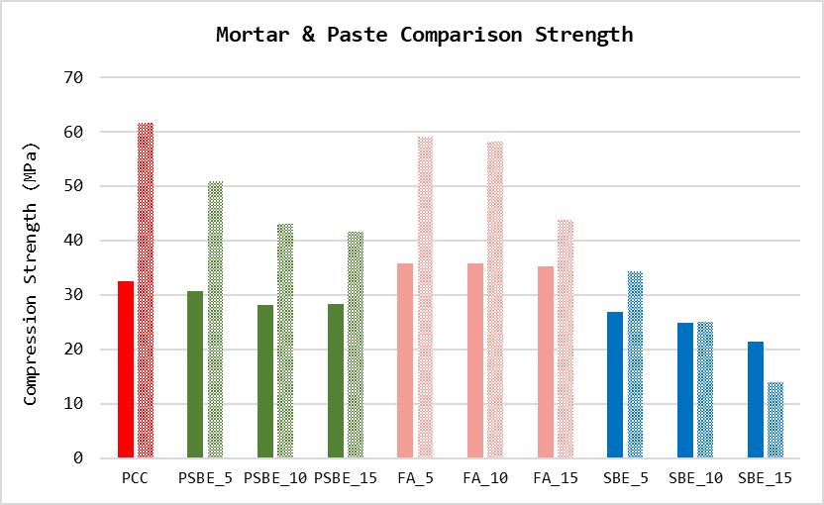
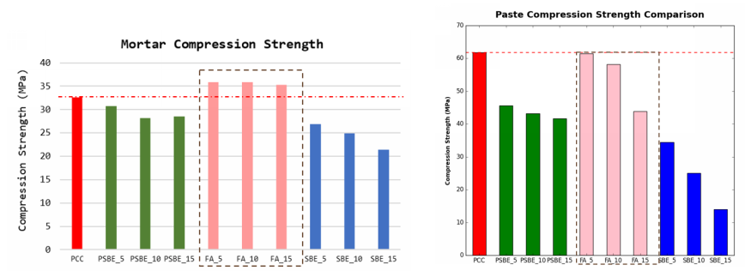
Pozzolanic Reaction is Observed to be active in either concrete or mortar. It is observed that fly ash “competes” with cement in paste samples (Naganathan & Linda, 2013).
! Larger replacement quantity would lead to greater decrease of both mortar and paste compressive strength

Slide 20
Conclusion
1. Acetone Ratio Doesn’t Have Any Clear Correlation with PSBE Oil Content
2. It is found that there’s four elements that increases after SBE is treated (chem not primary):
Illite => Causes water disruption (Consistency and stuffs)
Sodalite => Increases Material Strength & Durability
Cristobalite => Causes Instability (due to the phase changing); Decreases strength
Gaylusite => Slight Improvement of Workability (but the amount is relatively small)
3. PSBE decreases both paste and mortar strength. However, using PSBE is better than not treating SBE at all.

Slide 21
Thank You
谢谢大家 ☺

